Slide 1


Modernize your Windows desktop applications with .NET Core 3.0, Universal Windows Platform, XAML Islands and MSIX

Slide 2












“Will my LOB desktop Apps just run in Windows 10?”
“…my goal is to reduce App packaging and deployment costs…”
“…Upgrading framework for my solution is expensive… there are many components involved…”
“…we have many LOB Apps that rely on WinForms and WPF….what should I do with them?”
“…My users need
Apps that work best with keyboard and mouse…”
“…I want to enhance my App by adding windows 10 but don’t want to rewrite my App…”
Notes:
As we spoke to customers around the world, we heard some interesting things, and came to some consistent themes.
First, we heard that Win10 migration is on top of mind for lot of companies and there are lot of questions around getting ready for Win10. Especially given all the investments that have gone to app portfolio over the years, companies are curious on the next steps.
Have you ever heard how is complex to modernize applications
Block because of the .NET upgrade
Clean and modern packaging an updates
How can I be sure that he app work with touch and mouse
How can enhance use the latest Windows 10 features
With XAML Islands, we can use UWP controls in non-UWP desktop applications so that we can enhance the look, feel, and functionalities
This means that you can use UWP features such as Windows Hello, Ink and controls that support the Fluent Design System in your existing WPF, Windows Forms, and C++ Win32 applications.

Slide 3
Most PCs are or soon will be on Windows 10
96% of enterprise customers piloting Windows 10
+700M
active devices around the world running Windows 10
~2/3 of organizations will complete Windows migration in less than a year**
14 months Payback period for Windows 10 deployment costs*
85% of Enterprises will have started Windows 10 deployments by the end of the year**
33% reduction in security issues and resolution time*
49% of Enterprises named security improvements as a driver for planned Windows 10 deployment**
* ”The Total Economic Impact of Windows 10”; Forrester,
** “User Survey Analysis: Windows 10 looks heathy;”
Notes:
In this year’s Build conference held in Seattle, we declared that Windows 10 in “now the most used version of Windows in the planet”.
More than 700 million devices around the world are now running Windows 10 and business customers continue to demand more compatible, more innovative, and more productive applications.
Whether it’s the improvements around security and identity, the better browsing and cross-platform integration, or the modern Windows devices that allow you to do more things, faster—Windows 10 enables you to provide better solutions for your organization and for your customers than ever before.

Slide 4
+700M
active devices around the world running Windows 10
~2/3 of organizations will complete Windows migration in less than a year**
14 months Payback period for Windows 10 deployment costs*
85% of Enterprises will have started Windows 10 deployments by the end of the year**
33% reduction in security issues and resolution time*
49% of Enterprises named security improvements as a driver for planned Windows 10 deployment**
Most customers want to move to Windows 10 as soon as possible for security and app deployment advantages, well before Windows 7 End Of Support January 2020
* ”The Total Economic Impact of Windows 10”; Forrester
** “User Survey Analysis: Windows 10 looks heathy;” Gartner
Notes:
Beyond just the benefits of Windows 10, you need to be aware of the important date that is just around the cornet – Jan 2020 for the EOL for Win7 support.

Slide 5


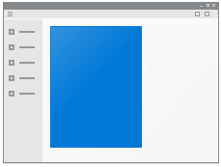
Current investments on Desktop Apps
WinForms
WPF
UWP
Web
Others
Notes:
We understand that companies and developers have invested a lot for many years to build their existing assets, and today, they have a wide variety of Apps on different languages, architectures and targeting different platforms….

Slide 6
Current investments on Desktop Apps
WinForms
WPF
UWP
Web
Others
Notes:
[just animation - the presentation will automatically go to next slide after the animation ends]

Slide 7
Multiple Journeys to help evolve Desktop Apps
Current investments on Desktop Apps
2
Leverage
3
Enhance
1
Apps Just
Run
4
New
experiences
Notes:
…We also understand that each application is different and for each application the goal might also be different, depending on many factors, such as:
what’s the overall strategy on the organization
What are the new requirements for an Application
What is the new technology that we want to take advantage of
How much we can invest to improve an App
Do we need to reuse the existing source code, business logic or UI?
And more.
For that reason, we have structured the ways an app can evolve into 4 different paths.
Let’s dig into each one of these

Slide 8
The challenge of modernizing the desktop ecosystem Rationalizing two distinct scenarios
Modern Application
Desktop Application
Contained Execution & Great Fundamentals
Platform Managed Install & Update
Trusted Distribution & Signed Packages
Modern UI
Cloud First Data with Insights
Designed for Reuse

Slide 9
The challenge of modernizing the desktop ecosystem Rationalizing two distinct scenarios
Modern Application Attributes
Desktop Application Attributes
Desktop Application
Contained Execution & Great Fundamentals
User & Admin Level Security
Platform Managed Install & Update
MSI, Custom Installers & Updaters
Trusted Distribution & Signed Packages
Web, SCCM & Custom Distribution
Modern UI
Windows Forms, WPF, MFC, etc.
Cloud First Data with Insights
Local Data
Designed for Reuse
Designed for Windows Desktop Only

Slide 10
The challenge of modernizing the desktop ecosystem Rationalizing two distinct scenarios
Modern Application Attributes
Desktop Application Attributes
Contained Execution & Great Fundamentals
User & Admin Level Security
Platform Managed Install & Update
MSI, Custom Installers & Updaters
Trusted Distribution & Signed Packages
Web, SCCM & Custom Distribution
Modern UI
Windows Forms, WPF, MFC, etc.
Cloud First Data with Insights
Local Data
Designed for Reuse
Designed for Windows Desktop Only

Slide 11
Enable all desktop scenarios in modern apps
Modern
Desktop
Modern Application Platform
Desktop Application Scenarios
Notes:
Windowing

Slide 12
Decouple modern platform into a la carte features
Modern
Desktop
Modern Application Platform Features
Desktop Applications
Notes:
Capability model
UX - XAML
Devices & Sensors (ie: BluetoothLE)
XAML, Ink, Media, Speech/Cortana
Mixed Reality/3D, Machine Learning
New Input modes - Eye tracking

Slide 13
Bring both platforms closer together
Modern
Desktop
Modern Application Platform
Desktop Application
Platform

Slide 14
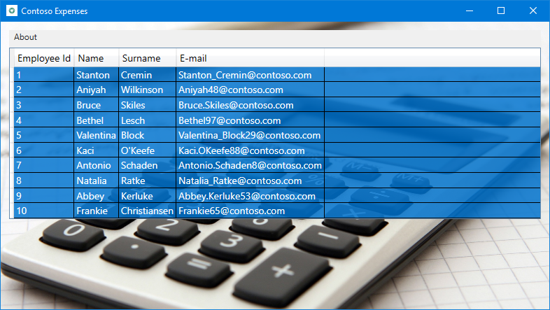
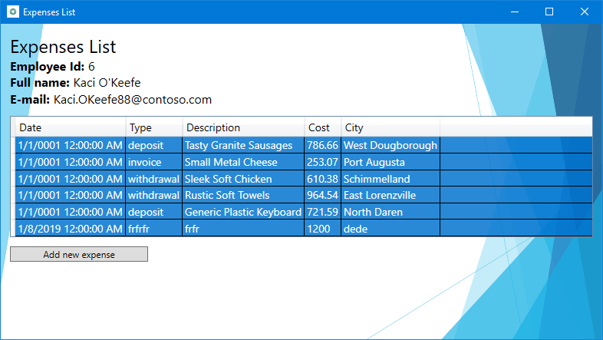
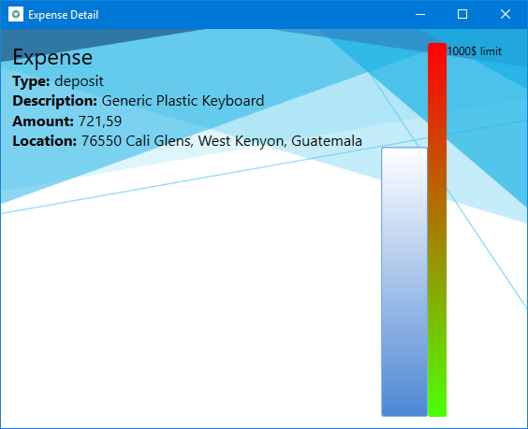
Welcome to the lab!
Let’s modernize this “good old new” WPF application!

Slide 15
Some of the characteristics of the application
WPF application based on .NET Framework 4.7.2
Built with the MVVM pattern
It has a separate business library
It leverages some 3° party libraries, like:
MVVM Light
Unity
LiteDB

Slide 16
Migrate to .NET Core 3.0
Exercise 1

Slide 17





Enhancing your Desktop assets - .NET Core
.NET Core
3
2
.NET Core 3 expands supported workloads to include Windows Desktop, IoT & AI
.NET Core is perfectly suited for the requirements of cloud-native, cross-platform workloads
WEB
CLOUD
DESKTOP
IoT
AI
.NET CORE
.NET CORE 3
LIBRARIES
INFRASTRUCTURE
RUNTIME COMPONENTS
COMPILERS
LANGUAGES
Notes:
.NET Core is our cross-platform, open source implementation of .NET and is perfectly suited for requirements of cloud-native, cross-platform services. We’ve made significant investments in the core performance as well as the web stack so that you can easily take advantage of cloud patterns and scale.
.NET Core 3 will expand on the supported workloads to include IoT, AI and Windows Desktop.

Slide 18
.NET Core 3 Desktop
Enhancing your Desktop assets - .NET Core
Improvements
Benefits
.NET Core 3 supports WinForms and WPF frameworks
XAML Islands - WinForms & WPF can host UWP
XAML Controls – Modern browser and media controls for WinForms & WPF
High DPI fixes for WinForms
Access to all Windows 10 API’s
.NET Core App Bundler
Precompiled, fast startup
Small apps by removing unused dependencies, link away unused IL
Single self-contained .exe
Side by side
Machine global or app local framework
Core runtime and API improvements
SDK based .csproj project system
Notes:
.NET Core 3 supports WinForms and WPF frameworks​:
- XAML Islands - WinForms & WPF can host UWP​
- XAML Controls – WinForms & WPF browser and media UWP controls​
- High DPI fixes for WinForms​

Slide 19



Update .NET Framework Apps
Modernize Desktop Apps with .NET Core 3
Highly compatible updates
.NET Core 3.0 with Desktop Packs
Install .NET Core updates per your
needs
Existing App
.NET Framework 4.8
Desktop Packs
.NET Core 3
Windows-only
Windows-only
Cross-platform
Highly-compatible, targeted improvements, like last few releases
UWP
WEB
DATA
AI/ML
WPF
ASP.NET Core
EF Core
ML.NET
Windows Forms
EF6 (cross-plat)
.NET STANDARD
.NET STANDARD
.NET Framework support unchanged (supported for life of Windows)

Slide 20
Migrate to .NET Core 3.0 - Overview
Use Portability Analyzer for a preliminary analysis of the compatibility of your solution
Move your libraries to .NET Standard 2.0
Use Windows Compatibility Pack to add support for Windows specific features
Use .NET Analyzer to detect APIs which won’t run cross-platform

Slide 21
Migrate a WPF application
Demo

Slide 22
Exercise 1 – 30 minutes
Migrate to .NET Core 3

Slide 23
.NET Core 3.0 migration - recap
Move your libraries to the new .csproj format
Move your libraries to .NET Standard 2.0
Use Microsoft.Windows.Compatibility to add support for Windows specific features
(Optional) Use Microsoft.DotNet.Analyzers.Compatibility to detect APIs which won’t run cross-platform
Upgrade your desktop app to .NET Core 3.0
(Optional) Cross-link files between the .NET Framework project and the .NET Core one if you want designers

Slide 24





Enhancing your Desktop App
Windows
Machine
Learning
Ink powered experiences
.NET Core 3
UWP APIs
XAML Controls
App Containers
Notes:
Moving forward we want to break the boundary between Win32 and UWP. We want to make the Modern platform just another set of capabilities you can access from any of your apps. Additionally we want to make it easier for Modern Apps to have powerful desktop capabilities. This allows us to move to a model where there is just one app platform.​
​
This means that you can start with a win32 App, and then start calling UWP APIS, from it straight forward.
You can also start adding modern UI components using Fluent design system on your win32 app
You can also start adding Windows ML easily with the win32 or UWP APIs, or Ink functionality.
Or can start compiling with .NET Core 3
Or packaging your Apps as MSIX to take advantage of Isolation, Clean install/uninstall or incremental updates.

Slide 25




And more…
Notes:
And more modern features can be added easily to your desktop App, without having to fully rewrite it.
Some Enterprises already interested on being early adopters such as…. [to be confirmed customer names adopting .NET Core, XAML Islands and Ink]

Slide 26
Add a UWP control with XAML Islands
Exercise 2

Slide 27
The architecture
Control Wrappers
Custom Controls
OSS Projects
Your Code
App Code
UWP XAML Host - WPF
UWP XAML Host - WinForm
HWND
XAML Bridge Source WinRT API
HWND
Platform
UWP XAML Control
Notes:
The DesktopWindowXamlSource is the actual instance of your Islands content. It has a Content property which you can instantiate and set with the control you want to render.
With an instance of the DesktopWindowXamlSource class you can attach its HWND to any parent HWND you want from your native Win32 App. This enables any framework that exposes HWND to host a XAML Island, including 3rd party technologies like Java or Delphi. However, when it comes to WPF and Windows Forms applications, you don’t have to manually do that thanks to the Windows Community Toolkit, since it already wraps these classes into ready-to-be-used controls.
XamlHost. It's a generic control that can host any UWP control
Controls, which includes wrappers for 1st party controls like Map or InkCanvas. Thanks to these controls, you'll be able to leverage them like if they're native WPF or Windows Forms control, including direct access to the exposed properties and binding support.

Slide 28
Windows Community Toolkit wrappers – 1st party control
Your WPF/WinForms app
WPF/WinForms
Control Wrappers
Xaml Controls Wrappers
WindowsXamlHost
No WinRT concepts
NuGet Packages for Windows Forms and WPF
Designer Support

Slide 29
XAML Control Wrappers
Html 5 support
Most requested feature in UserVoice
No using DWXS API
Works on April 2018 Update
Tilted & Rotated views
Offline Support
3D data
Streetside
Traffic
Closed Captioning
Smooth Streaming
Adapted bitrates
Additional codecs support
Better power utilization
Custom Xaml content
WebView (EdgeHtml)
Map Control
MediaPlayerElement
Native DirectX11 support
Native DirectX12 support
Multithreading support
High DPI
HDR rendering
Super-wet Ink
Ink Toolbar
Text recognition
Shape recognition
Store and retrieve ink
Microsoft Graph
Microsoft 365
Azure AAD
Office 365
Enterprise Mobility
Windows 10
WindowsXamlHost
SwapChainPanel
Ink Canvas
Graph
Shipped in Preview
In development

Slide 30
Exercise 2 – 20 minutes
Add a UWP control with XAML Islands

Slide 31
What you’ve done!
You referenced the NuGet package Microsoft.Toolkit.Wpf.UI.Controls (This package provides out of the box XAMLIslands 1st party controls)
You used the InkCanvas which is a rich touch/pen/mouse enabled controls to draw on a surface
Notes:
This slide is required. Do NOT delete. This slide is recommended just prior to the “session resources” slide
SESSION TAKEAWAYS & ACTIONS: Bullet points highlighting the primary actions learners should take away or knowledge learners should recall to help them successfully perform in role (e.g. practical guidance, tips, suggested behavior changes.)
Please Note: Session Takeaways are not required to be noted in this slide for Group Discussions (formerly known as Chalk Talks) or Workshop sessions; however, takeaways should be captured real time by the facilitator during the session and those key points should be emphasized during the discussion or workshop. If you have questions, please contact your Track Content Lead.

Slide 32
Add any UWP control with XAML Islands
Exercise 2

Slide 33
Windows Community Toolkit – WindowsXamlHost
UWP Control
WPF/WinForms
WindowsXamlHost
Host for any UWP Control
Dedicated NuGet package:
WPF: https://www.nuget.org/packages/Microsoft.Toolkit.Wpf.UI.XamlHost/
Windows Forms: https://www.nuget.org/packages/Microsoft.Toolkit.Forms.UI.XamlHost/
If you are using 1st party wrapped controls, the package is already installed since it’s a dependency

Slide 34
Using the control
<xamlhost:WindowsXamlHost InitialTypeName="Windows.UI.Xaml.Controls.CalendarView" ChildChanged="CalendarUwp_ChildChanged" />
The full signature of the control you want to render
You subscribe to this event to handle interaction with the control and to customize it

Slide 35
Using the control
private void CalendarUwp_ChildChanged(object sender, EventArgs e)
{
WindowsXamlHost windowsXamlHost = (WindowsXamlHost)sender;
Windows.UI.Xaml.Controls.CalendarView calendarView =
(Windows.UI.Xaml.Controls.CalendarView)windowsXamlHost.Child;
if (calendarView != null)
{
calendarView.SelectedDatesChanged += (obj, args) =>
{
};
calendarView.MaxDate = DateTimeOffset.Now;
}
}
This property has a reference to the hosted control
Event handling
Properties customization

Slide 36
Enhancing your Desktop assets – UWP APIs
Current status
Benefits
Windows features exposed thru UWP APIs
Devices & Sensors (ie: BluetoothLE)
XAML, Ink, Media, Speech/Cortana
Mixed Reality/3D, Machine Learning
New Input modes - Eye tracking
Most APIs available to Win32/.NET apps today!
DualApiPartition attribute – can call today
Some APIs require UWP Concepts
Identity – Requires MSIX package
CoreWindow – APIs show UI and XAML Controls requires XAML Islands
Add modern features to your existing Win32 WPF or WinForms applications with minimum code changes
Notes:
​As an existing Desktop Developer you can take advantage of UWP APIs and new UWP capabilities from your current desktop Apps
From a Win32 you can start calling UWP Apps, by using the desktop bridge
With windows Grouping APIs YOU own the customer experience in your apps by overriding the global preference for Windows
Your apps can participate in Windows timeline
You can also control the visual of your apps and the tab visual.

Slide 37
Exercise 3 – 25 minutes
Add any UWP control with XAML Islands

Slide 38
What you’ve done!
We have used for the first time a generic control from the Universal Windows Platform: the CalendarView one
Since it isn’t a 1st party control, we had to use the WindowsXamlHost control from the toolkit
We’ve been able to interact with properties and event handlers exposed by the CalendarView control, even if we had to use a not super straightforward approach
Can we do better?
Notes:
This slide is required. Do NOT delete. This slide is recommended just prior to the “session resources” slide
SESSION TAKEAWAYS & ACTIONS: Bullet points highlighting the primary actions learners should take away or knowledge learners should recall to help them successfully perform in role (e.g. practical guidance, tips, suggested behavior changes.)
Please Note: Session Takeaways are not required to be noted in this slide for Group Discussions (formerly known as Chalk Talks) or Workshop sessions; however, takeaways should be captured real time by the facilitator during the session and those key points should be emphasized during the discussion or workshop. If you have questions, please contact your Track Content Lead.

Slide 39
Create a wrapper for a UWP control with XAML Islands
Exercise 4

Slide 40
The challenge
In the previous exercise we achieved our goal to expose a generic UWP control in our WPF application, but:
No binding support
No easy way to reuse the control in another window
Not really clean architecture

Slide 41
Let’s build a wrapper!
The toolkit includes APIs to host a UWP control in code
Build your own wrapper to expose properties and events
public class CalendarViewWrapper : WindowsXamlHostBase
{
protected override void OnInitialized(EventArgs e)
{
base.OnInitialized(e);
this.ChildInternal = UWPTypeFactory. CreateXamlContentByType("Windows.UI.Xaml.Controls.CalendarView");
SetContent();
Windows.UI.Xaml.Controls.CalendarView calendarView = this.ChildInternal as Windows.UI.Xaml.Controls.CalendarView;
}
}

Slide 42
Exercise 4 – 25 minutes
Create a wrapper for a UWP control with XAML Islands

Slide 43
Create a UWP wrapper for XAML Islands
Exercise 4

Slide 44
What you’ve done!
We have used again the CalendarView control, but in a better way
We were able to expose the property we need directly from the control
Thanks to dependency properties, we have been able to support binding and retain the MVVM architecture of our project
Notes:
This slide is required. Do NOT delete. This slide is recommended just prior to the “session resources” slide
SESSION TAKEAWAYS & ACTIONS: Bullet points highlighting the primary actions learners should take away or knowledge learners should recall to help them successfully perform in role (e.g. practical guidance, tips, suggested behavior changes.)
Please Note: Session Takeaways are not required to be noted in this slide for Group Discussions (formerly known as Chalk Talks) or Workshop sessions; however, takeaways should be captured real time by the facilitator during the session and those key points should be emphasized during the discussion or workshop. If you have questions, please contact your Track Content Lead.

Slide 45
Exercise 5 – Deploy your application with MSIX
Exercise 5

Slide 46

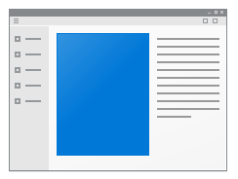


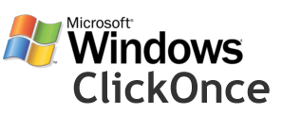
Evolve to a modern deployment technology
Setup.exe
MSI
script.vbs
MSIX

Slide 47

Key Benefits of MSIX
Disk space
Network optimization using differential updates
Modern IT Virtuous Cycle
Enable OS, Apps & IT to update independently
Simpler packaging and deployment
Declarative install via Manifest file
Identity, formal versioning and device targeting
Optimized
Never Regret Installing an app
Predictable, safe, and reliable deployment
Trusted, clean install & uninstall – no Win ROT
Notes:
MSIX is the evolution of MSI and designed to be a superset of the many packaging and deployment scenarios desktop applications require.
MSIX is designed to work for every app in large app catalogs and on every PC in an organization.
The key value prop is for customers to never regret installing an application regardless of where the package comes from internal or external. It will always provide a clean & trusted install and uninstall experience. Additional advantages include optimizations for differential updates and streaming installs.

Slide 48
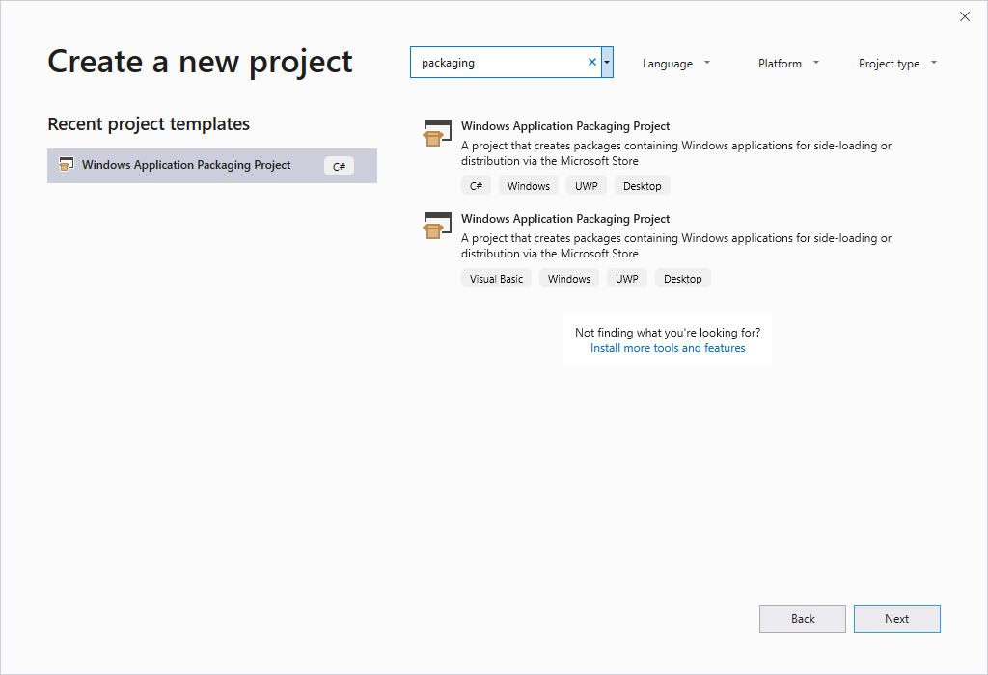
Windows Application Packaging Project
Projects included in VS 2017 and VS 2019
Easily debug packaged WPF, Windows Forms and Visual C++ from the source code
New! Now you can use it to embed any kind of application, even if you don’t own the source
New! Support to .NET Core 3.0 desktop apps

Slide 49

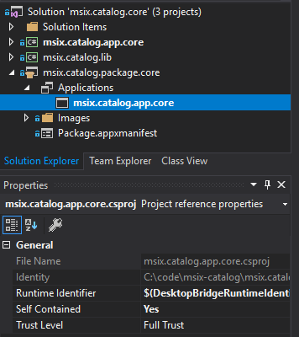
MSIX and .NET Core 3.0
Framework Dependent Deployment
Self Contained Deployment
MSIX default is Self Contained
Self Contained requires RIDs

Slide 50
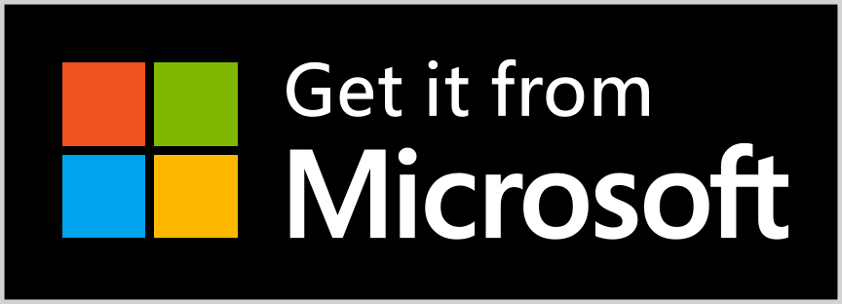



Great for DevOps
Publish on the Microsoft Store
Source control
CI / CD pipeline
Configurable silent updates
Update check on app launch
UX blocking updates (in preview)
APIs to check for updates
Publish on the web / file share using AppInstaller

Slide 51

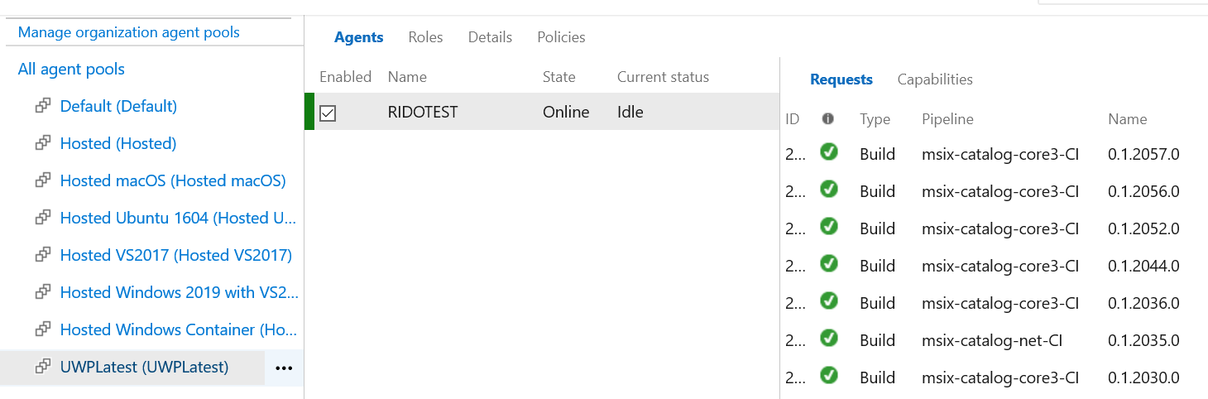
Builds
Hosted Agents vs. Custom Agents
Tool requirements
.NET Targeting Pack
.NET Core SDK
Windows SDK

Slide 52

Distribution
Store
Great for consumer apps
Signed with MS Cert
Multi-Device support
Flights
Auto Updates
Sideload
Great for testing, reduced distribution
Custom signing
Custom auto-updates
Great for enterprises (ala ClickOnce)
PRO TIP: Modify Package Identity to support Side by Side installations (e.g. Nightly Builds)

Slide 53
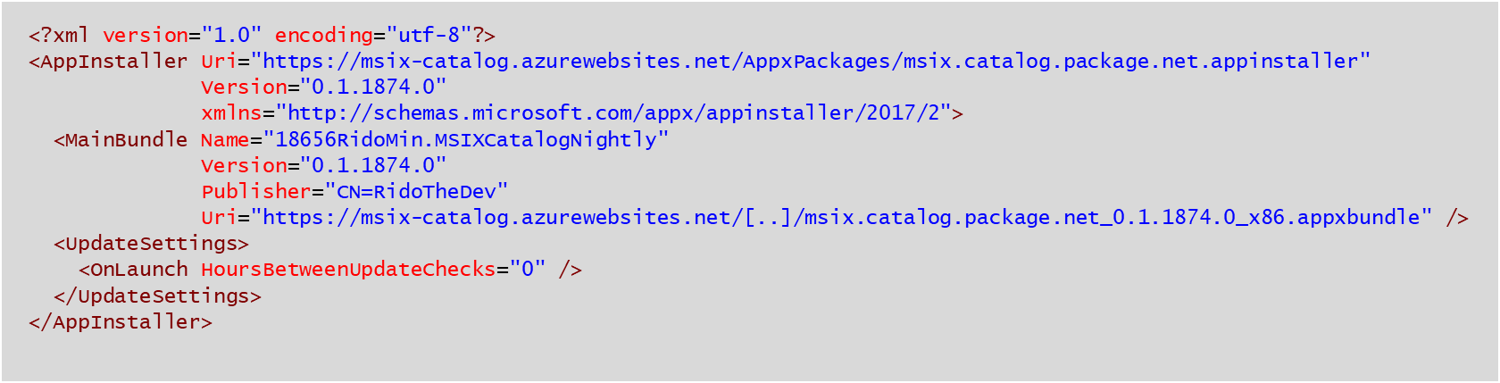
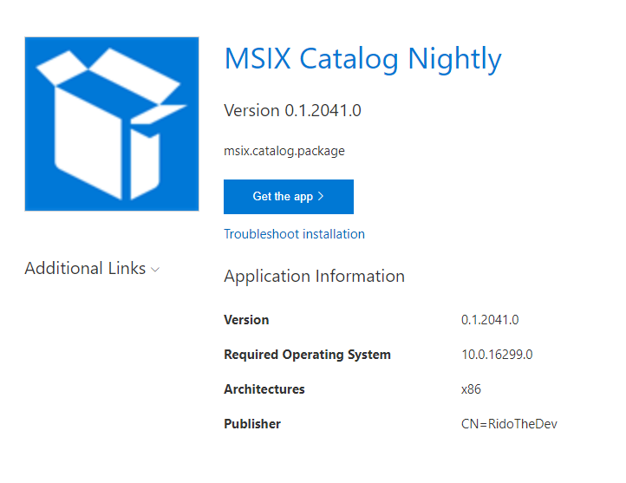
Automatic updates with the App Installer File
ms-appinstaller:?source=https://../../app.appinstaller

Slide 54
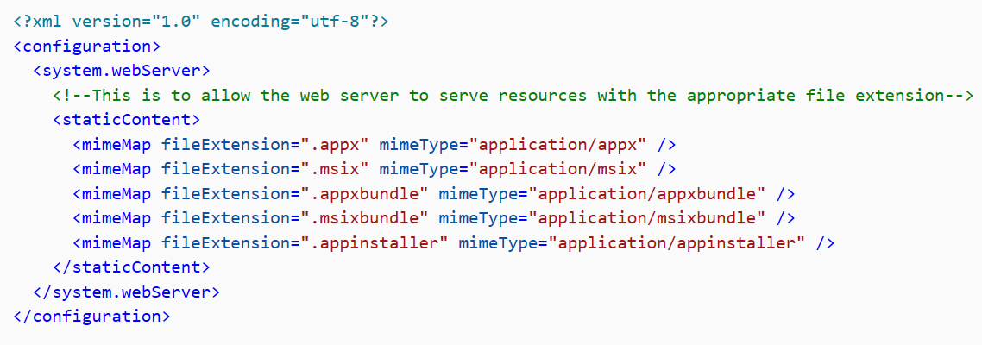
Host packages for sideloading

Slide 55
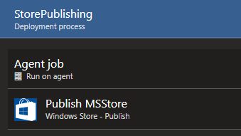
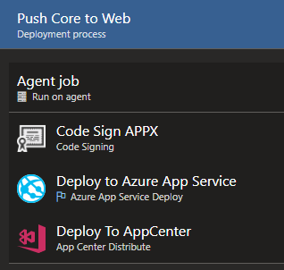
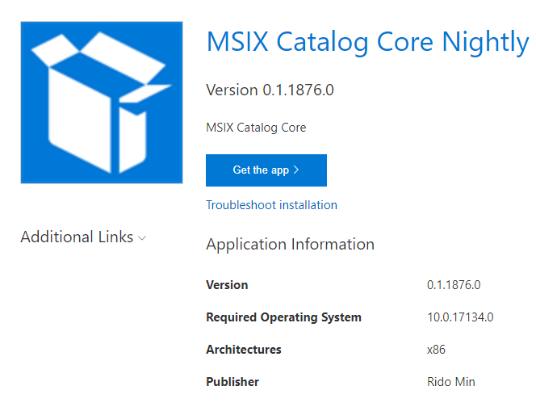
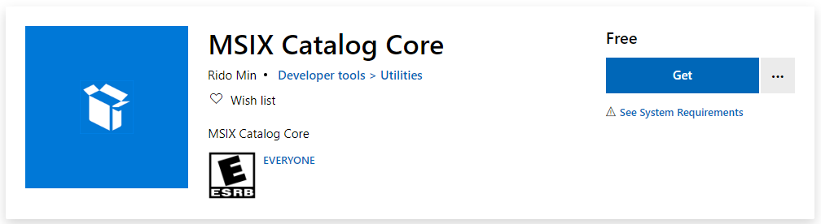
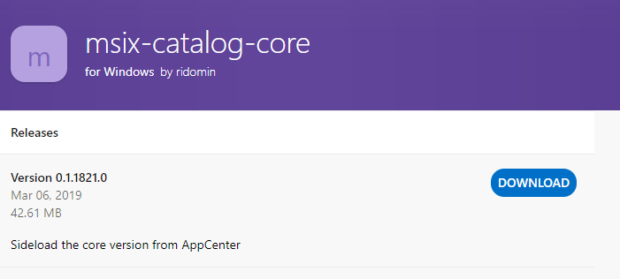
Distribute with Release Pipelines

Slide 56
Exercise 5 – Deploy your application with MSIX
Exercise 6

Slide 57
What you’ve done!
You have packaged the your WPF application with MSIX thanks to the Windows Application Packaging Project
Thanks to AppInstaller, it’s easy to deploy and update your application also through a website
Thanks to Visual Studio App Center, it’s easy to share your application to a group of testers
With Azure DevOps you can build a CI/CD pipeline which automates the whole deployment process, regardless if you want to publish on the Store, on a website or on Visual Studio App Center
Notes:
This slide is required. Do NOT delete. This slide is recommended just prior to the “session resources” slide
SESSION TAKEAWAYS & ACTIONS: Bullet points highlighting the primary actions learners should take away or knowledge learners should recall to help them successfully perform in role (e.g. practical guidance, tips, suggested behavior changes.)
Please Note: Session Takeaways are not required to be noted in this slide for Group Discussions (formerly known as Chalk Talks) or Workshop sessions; however, takeaways should be captured real time by the facilitator during the session and those key points should be emphasized during the discussion or workshop. If you have questions, please contact your Track Content Lead.

Slide 58




Takeaways!
Modernization brings more value to users
Developers don’t have to rewrite their apps to modernize
.NET Core 3.0 is the future also for Windows developers
Be more agile by enabling a CI/CD pipeline

Slide 59
References
Demos: https://aka.ms/MADN-Workshop
MSIX http://aka.ms/msix
AppConsult Blog: http://aka.ms/appconsultblog
.NET Core 3.0: https://dotnet.microsoft.com/download
Portability Analyzer: http://aka.ms/portabilityanalyzer

Slide 60
Thanks!
Matteo Pagani
Windows AppConsult Engineer
matteo.pagani@microsoft.com
@qmatteoq
Notes:
Display this slide during session Q&A and direct attendees to use the Q&A microphone located in the session room:
Digital Ready session recordings cannot capture Q&A unless it is spoken using the microphone
Attendees in the back of the room may not be able to hear a question from someone in the front of the room
SPEAKERS MUST REPEAT THE QUESTIONS IF THE ATTENDEE IS NOT USING THE Q&A MICROPHONE

